Slide 1

The Battle of Neighborhoods - Week 5 Title: Restaurant Recommender System for Chennai

Slide 2
Data Requirements
To build a Restaurant Recommender model for Chennai location, we need below data:
Chennai’s geographical coordinates (latitude and longitude) to find neighborhood details.
Population of the neighborhood where the restaurant is located.
Restaurant details in locality and its cuisines.

Slide 3
Data Requirements (contd)..
Let’s take detail look at each of these:
To access each restaurants in neighborhood location, we need it’s Latitude and Longitude so that we can point at its coordinates and create a map displaying all the restaurants with its labels respectively.
Population of a neighborhood is very important factor to determine a restaurant's growth. More people visit, better the restaurant will be rated because it is accessed by different people with different taste.
Income level of a neighborhood is also very important factor. If people in a neighborhood earns more than an average income, then it is likely that they will spend more. So restaurant can access market demand to income of a neighborhood.

Slide 4
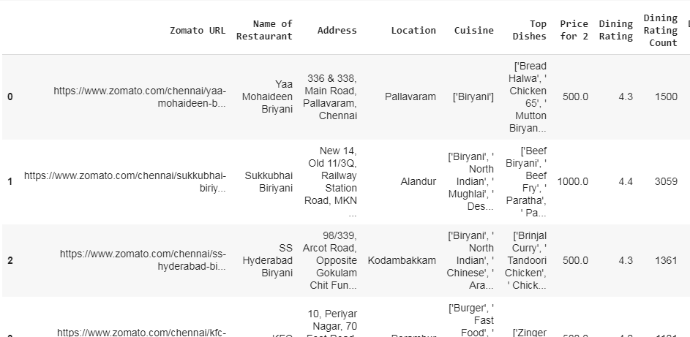
Data Collection
I have used Zomato's Chennai restaurant 2020 details for this project.
This dataset have list of all restaurants which were served by zomato delivery team along with location and ratings details.
Dataset will looks like below:

Slide 5
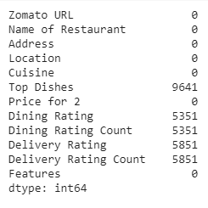
Data Pre-Processing
Preprocess the Data to clean the dataset and impute with NaN values.
Preprocess summary was shown below:

Slide 6
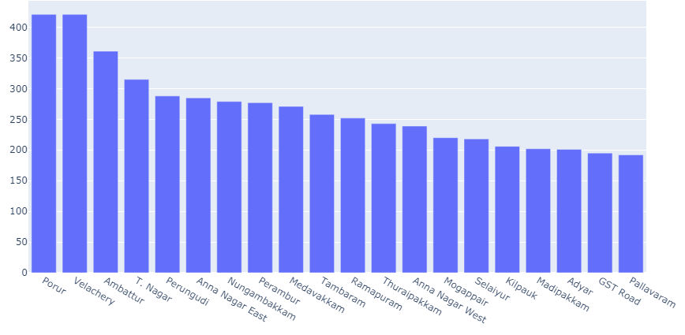
Pre-Processing Reports
Chennai Restaurants - Location wise
Porur and Velachery have highest number of restaurants.

Slide 7
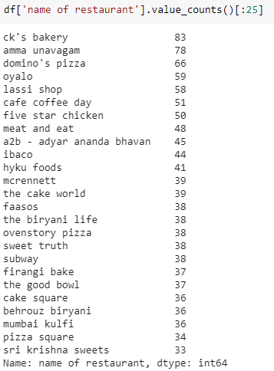
Pre-Processing Reports
Chennai Restaurants – Franchise wise
Ck’s Bakery and Amma Unavagam have highest number of restaurant outlets.

Slide 8
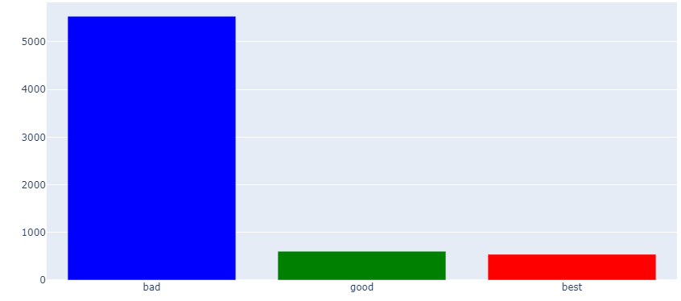
Pre-Processing Reports
Rating Distribution wise - Dine only Ratings
More than 5000 ratings were Bad and only few ratings were Good and Best.

Slide 9
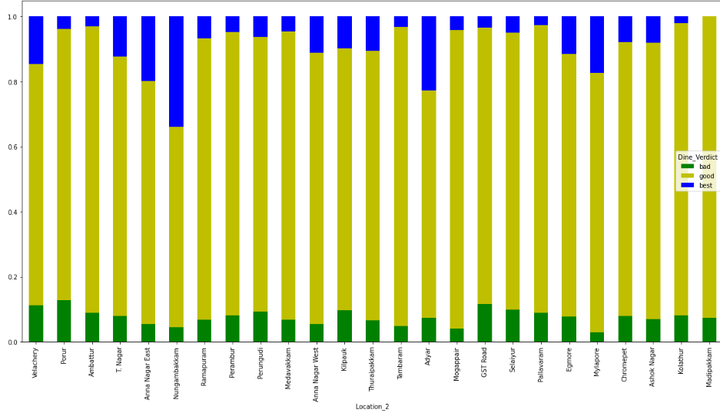
Pre-Processing Reports
Location wise Ratings - Dine only Ratings
Velachery and Porur have higher number of user ratings.

Slide 10
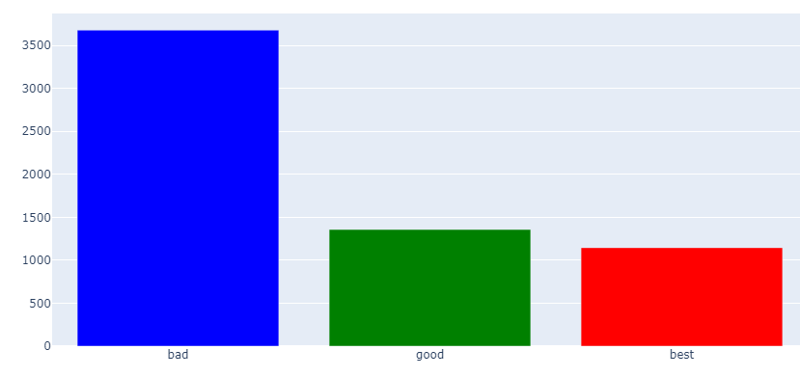
Pre-Processing Reports
Rating Distribution wise - Delivery only Ratings
More than 3500 ratings were Bad and only few ratings were Good and Best.

Slide 11
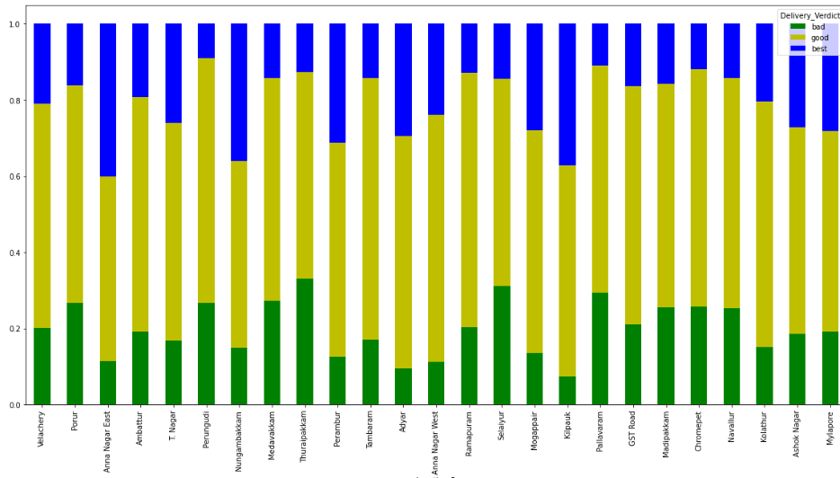
Pre-Processing Reports
Location wise Ratings - Delivery Rating only
Velachery and Porur have higher number of user ratings.

Slide 12
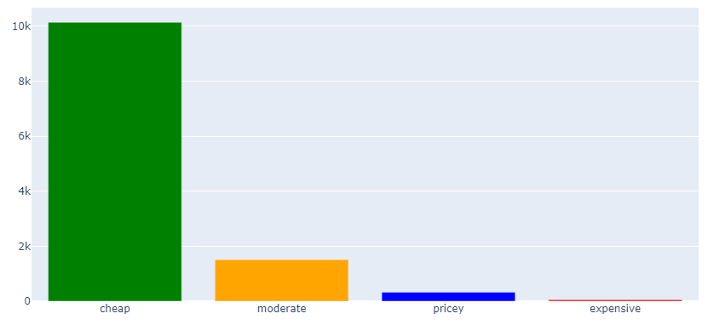
Pre-Processing Reports
Price Comparison - Location wise
More than 10k users have rated the food price as cheap.

Slide 13
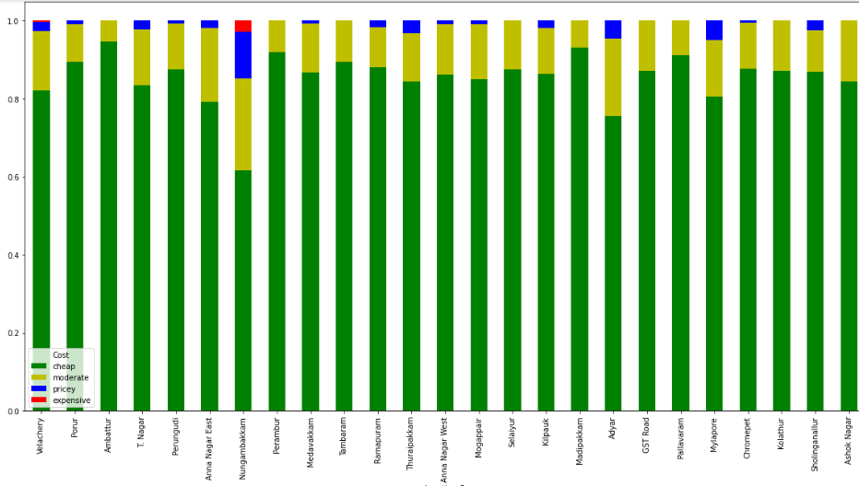
Pre-Processing Reports
Price Comparison - Location wise
Velachery and Porur have higher number of user ratings.

Slide 14
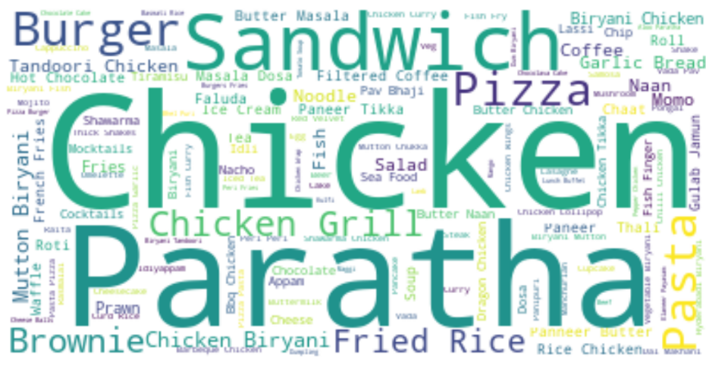
Reports
Top Dishes in Chennai
Chicken and Paratha were the top dishes ordered in Chennai

Slide 15
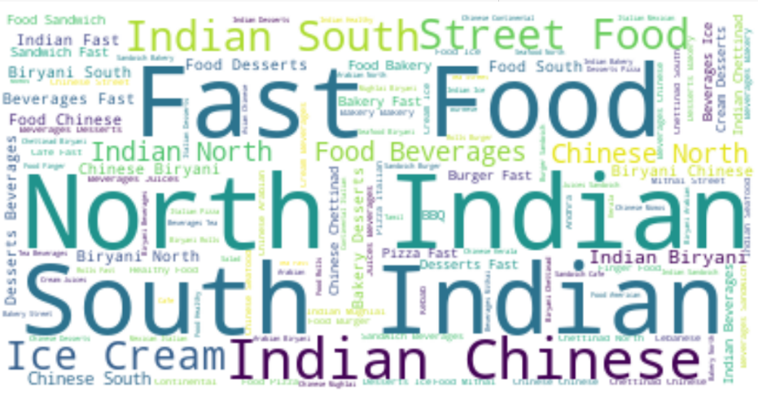
Reports
Popular Cuisines served in Chennai
North Indian and South Indian were the top cuisines ordered in Chennai

Slide 16
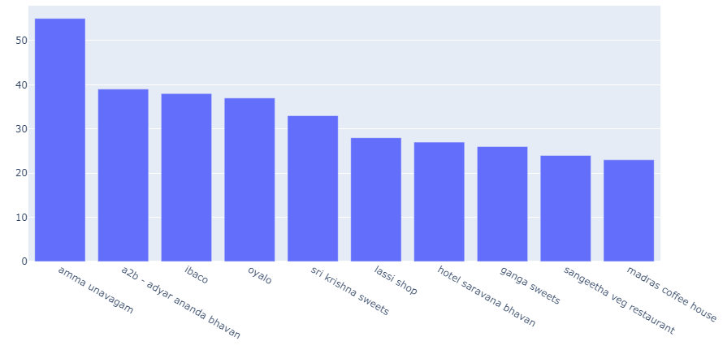
Reports
Restaurants which serve Vegetarian food in Chennai
Amma Unavagam and Adyar Anandha Bhavan have higher number of Veg restaurants chain.

Slide 17
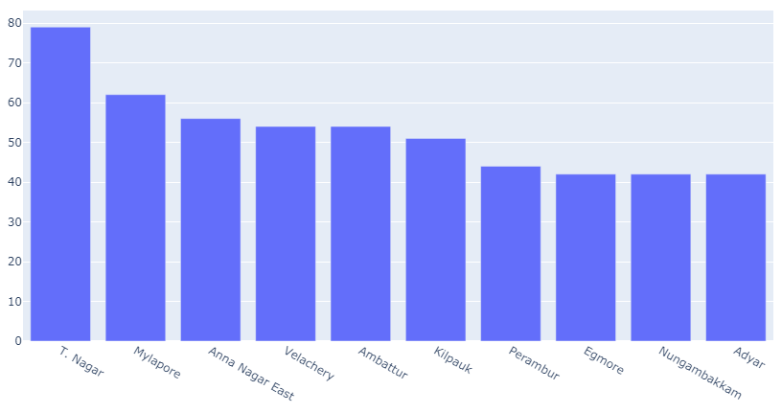
Reports
Locations with maximum Vegetarian Restaurants
T.Nagar and Mylapore have higher number of Veg restaurants.

Slide 18
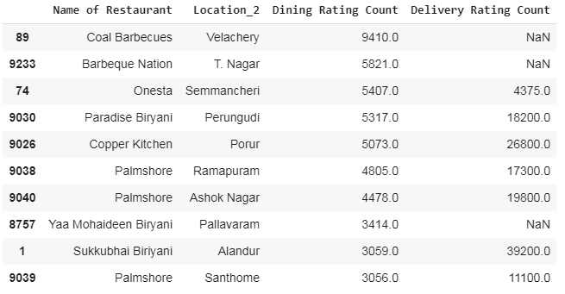
Reports
Most Popular Restaurants in Chennai
Coal Barbecues and Barbeque Nation were the most popular Restaurants in Chennai.

Slide 19
Conclusion
Chennai have most varieties of restaurants which serves North Indian to South Indian, Continental to Chinese food.
All major Restaurant chains have restaurants in all parts of Chennai.
Chennai have both cheap Restaurant food and also have expensive Restaurant food.
Due to wide range in price and cuisines, Chennai is the best place to dine.

